Slide 1
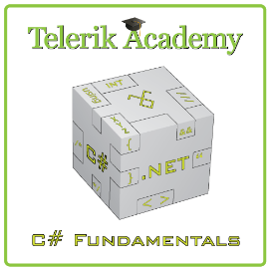


Math Expressions Calculator
http://csharpfundamentals.telerik.com
RPN and Shunting-yard algorithm
Ivaylo Kenov
Technical Assistant
Ivaylo.Kenov@Telerik.com
Telerik Software Academy
academy.telerik.com

Slide 2

Table of Contents
Pre-requirements
List
Stack
Queue
Reverse Polish Notation
Explanation
Calculator algorithm
Shunting-yard algorithm
Converting expressions to RPN

Slide 3



Pre-requirements
List, Stack, Queue

Slide 4
The List ADT
What is "list"?
A data structure (container) that contains a sequence of elements
Can have variable size
Elements are arranged linearly, in sequence
Can be implemented in several ways
Statically (using array → fixed size)
Dynamically (linked implementation)
Using resizable array (the List<T> class)

Slide 5
The List<T> Class
Implements the abstract data structure list using an array
All elements are of the same type T
T can be any type, e.g. List<int>, List<string>, List<DateTime>
Size is dynamically increased as needed
Basic functionality:
Count – returns the number of elements
Add(T) – appends given element at the end

Slide 6
List<T> – Simple Example
static void Main()
{
List<string> list = new List<string>() { "C#", "Java" };
list.Add("SQL");
list.Add("Python");
foreach (string item in list)
{
Console.WriteLine(item);
}
// Result:
// C#
// Java
// SQL
// Python
}
Inline initialization: the compiler adds specified elements to the list.

Slide 7
List<T> – Functionality
list[index] – access element by index
Insert(index, T) – inserts given element to the list at a specified position
Remove(T) – removes the first occurrence of given element
RemoveAt(index) – removes the element at the specified position
Clear() – removes all elements
Contains(T) – determines whether an element is part of the list

Slide 8
List<T> – Functionality (2)
IndexOf() – returns the index of the first occurrence of a value in the list (zero-based)
Reverse() – reverses the order of the elements in the list or a portion of it
Sort() – sorts the elements in the list or a portion of it
ToArray() – converts the elements of the list to an array
TrimExcess() – sets the capacity to the actual number of elements

Slide 9
List<T>: How It Works?
Capacity
List<int>:
Count = 9
Capacity = 15
3 | 4 | 1 | 0 | 0 | 7 | 1 | 1 | 4
used buffer
(Count)
unused buffer
List<T> keeps a buffer memory, allocated in advance, to allow fast Add(T)
Most operations use the buffer memory and do not allocate new objects
Occasionally the capacity grows (doubles)

Slide 10

List<T>
Live Demo

Slide 11
The Stack ADT
LIFO (Last In First Out) structure
Elements inserted (push) at “top”
Elements removed (pop) from “top”
Useful in many situations
E.g. the execution stack of the program
Can be implemented in several ways
Statically (using array)
Dynamically (linked implementation)
Using the Stack<T> class

Slide 12
The Stack<T> Class
Implements the stack data structure using an array
Elements are from the same type T
T can be any type, e.g. Stack<int>
Size is dynamically increased as needed
Basic functionality:
Push(T) – inserts elements to the stack
Pop() – removes and returns the top element from the stack

Slide 13
The Stack<T> Class (2)
Basic functionality:
Peek() – returns the top element of the stack without removing it
Count – returns the number of elements
Clear() – removes all elements
Contains(T) – determines whether given element is in the stack
ToArray() – converts the stack to an array
TrimExcess() – sets the capacity to the actual number of elements

Slide 14
Stack<T> – Example
Using Push(), Pop() and Peek() methods
static void Main()
{
Stack<string> stack = new Stack<string>();
stack.Push("1. Ivan");
stack.Push("2. Nikolay");
stack.Push("3. Maria");
stack.Push("4. George");
Console.WriteLine("Top = {0}", stack.Peek());
while (stack.Count > 0)
{
string personName = stack.Pop();
Console.WriteLine(personName);
}
}

Slide 15

Stack<T>
Live Demo

Slide 16
The Queue ADT
FIFO (First In First Out) structure
Elements inserted at the tail (Enqueue)
Elements removed from the head (Dequeue)
Useful in many situations
Print queues, message queues, etc.
Can be implemented in several ways
Statically (using array)
Dynamically (using pointers)
Using the Queue<T> class

Slide 17
The Queue<T> Class
Implements the queue data structure using a circular resizable array
Elements are from the same type T
T can be any type, e.g. Queue<int>
Size is dynamically increased as needed
Basic functionality:
Enqueue(T) – adds an element to the end of the queue
Dequeue() – removes and returns the element at the beginning of the queue

Slide 18
The Queue<T> Class (2)
Basic functionality:
Peek() – returns the element at the beginning of the queue without removing it
Count – returns the number of elements
Clear() – removes all elements
Contains(T) – determines whether given element is in the queue
ToArray() – converts the queue to an array
TrimExcess() – sets the capacity to the actual number of elements in the queue

Slide 19
Queue<T> – Example
Using Enqueue() and Dequeue() methods
static void Main()
{
Queue<string> queue = new Queue<string>();
queue.Enqueue("Message One");
queue.Enqueue("Message Two");
queue.Enqueue("Message Three");
queue.Enqueue("Message Four");
while (queue.Count > 0)
{
string message = queue.Dequeue();
Console.WriteLine(message);
}
}

Slide 20

The Queue<T> Class
Live Demo

Slide 21
Reverse Polish Notation
Postfix visualization of expressions

Slide 22
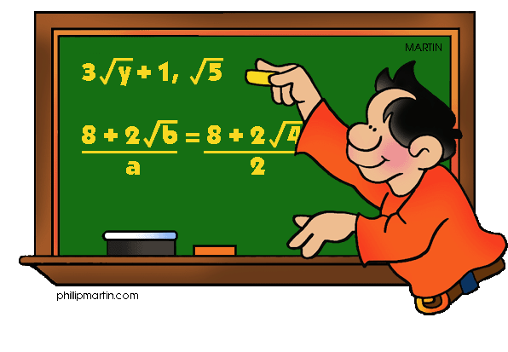
Notation Types
Three notation types
Prefix – Example: 5 – (6 * 7) converts to – 5 * 6 7
Infix – Example: 5 – (6 * 7) is 5 – (6 * 7)
Postfix – Example: 5 – (6 * 7) converts to 5 6 7 * -
Reverse Polish Notation is postfix
Benefits
No parentheses
Easy to calculate
Easy to use by computers

Slide 23
RPN Algorithm
While there are input tokens left
Read the next token from input
If the token is a value – push it into the stack
Else the token is an operator (or function)
It is known that the operator takes n arguments.
If stack does not contain n arguments – error
Else, pop n arguments – evaluate the operator
Push the result back into the stack
If stack contains one argument – it is the result
Else - error

Slide 24
RPN Algorithm Example (1)
Infix notation: 5 + ((1 + 2) * 4) − 3
RPN: 5 1 2 + 4 * + 3 –
Step 1 - Token: 5 | Stack: 5
Step 2 - Token: 1 | Stack: 5, 1
Step 3 - Token: 2 | Stack: 5, 1, 2
Step 4 - Token: + | Stack: 5, 3 | Evaluate: 2 + 1
Step 5 - Token: 4 | Stack: 5, 3, 4
Step 6 - Token: * | Stack: 5, 12 | Evaluate: 4 * 3

Slide 25
RPN Algorithm Example (2)
Infix notation: 5 + ((1 + 2) * 4) − 3
RPN: 5 1 2 + 4 * + 3 –
Step 6 - Token: * | Stack: 5, 12 | Evaluate: 3 * 4
Step 7 - Token: + | Stack: 17 | Evaluate: 12 + 5
Step 8 - Token: 3 | Stack: 17, 3
Step 9 - Token: - | Stack: 14 | Evaluate: 17 – 3
Result - 14

Slide 26
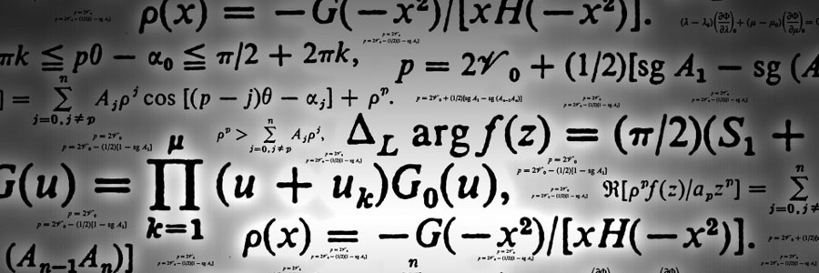
Shunting-yard Algorithm
Convert from infix to postfix

Slide 27

Shunting-yard Algorithm
Converts from infix to postfix (RPN) notation
Invented by Dijkstra
Stack-based
Two string variables – input and output
A stack holds not yet used operators
A queue holds the output
Reads token by token

Slide 28
Shunting-yard Algorithm (1)
While there are input tokens left
Read the next token from input
If the token is a number – add it into the queue
If the token is a function – push it into the stack
If the token is argument separator (comma)
Until the top of the stack is left parentheses, pop operators from stack and add them to queue
If left parentheses is not reached - error
If the token is left parentheses, push it into the stack

Slide 29
Shunting-yard Algorithm (2)
If the token is an operator A,
While
there is an operator B at the top of the stack and
A is left-associative and its precedence is equal to that of B,
Or A has precedence less than that of B,
Pop B of the stack and add it to the queue
Push A into the stack

Slide 30
Shunting-yard Algorithm (3)
If the token is right parentheses,
Until the top of the stack is a left parenthesis, pop operators off the stack onto the queue
Pop the left parenthesis from the stack, but not onto the queue
If the top of the stack is a function, pop it onto the queue
If left parentheses is not reached – error
If tokens end – while stack is not empty
Pop operators from stack to the queue
If parentheses is found - error

Slide 31
Shunting-yard Example (1)
Infix notation: 3 + 4 * 2 / ( 1 - 5 )
Step 1 - Token: 3 | Stack: | Queue: 3
Step 2 - Token: + | Stack: + | Queue: 3
Step 3 - Token: 4 | Stack: + | Queue: 3, 4
Step 4 - Token: * | Stack: +, * | Queue: 3, 4
Step 5 - Token: 2 | Stack: +, * | Queue: 3, 4, 2
Step 6 - Token: / | Stack: +, / | Queue: 3, 4, 2, *

Slide 32
Shunting-yard Example (2)
Infix notation: 3 + 4 * 2 / ( 1 - 5 )
Step 6 - Token: / | Stack: +, / | Queue: 3, 4, 2, *
Step 7 - Token: ( | Stack: +, /, ( | Queue: 3, 4, 2, *
Step 7 - Token: 1
Stack: +, /, ( | Queue: 3, 4, 2, *, 1
Step 8 - Token: -
Stack: +, /, (, - | Queue: 3, 4, 2, *, 1
Step 9 - Token: 5
Stack: +, /, (, - | Queue: 3, 4, 2, *, 1, 5

Slide 33
Shunting-yard Example (3)
Infix notation: 3 + 4 * 2 / ( 1 - 5 )
Step 9 - Token: 5
Stack: +, /, (, - | Queue: 3, 4, 2, *, 1, 5
Step 9 - Token: )
Stack: +, / | Queue: 3, 4, 2, *, 1, 5, -
Step 9 - Token: None
Stack: | Queue: 3, 4, 2, *, 1, 5, -, /, +
Result – 3 4 2 * 1 5 - / +

Slide 34

Expression Calculator
Combining the knowledge

Slide 35

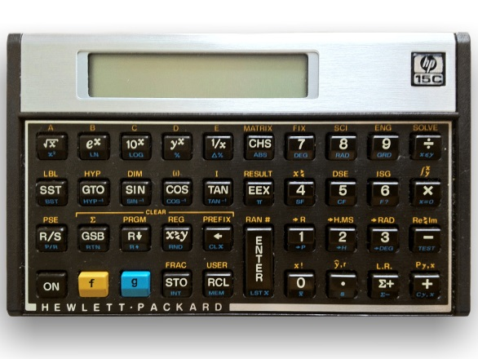
Expression Calculator
Read the input as string
Remove all whitespace
Separate all tokens
Convert the tokens into a queue - Shunting-yard Algorithm
Calculate the final result with the Reverse Polish Notation

Slide 36

Expression Calculator
Live Demo

Slide 37
Using Classes and Objects
http://csharpfundamentals.telerik.com

Slide 38


Free Trainings @ Telerik Academy
“C# Programming @ Telerik Academy
csharpfundamentals.telerik.com
Telerik Software Academy
academy.telerik.com
Telerik Academy @ Facebook
facebook.com/TelerikAcademy
Telerik Software Academy Forums
forums.academy.telerik.com

